Slide 1
AZ-305T00A Designing Microsoft Azure Infrastructure Solutions

Slide 2
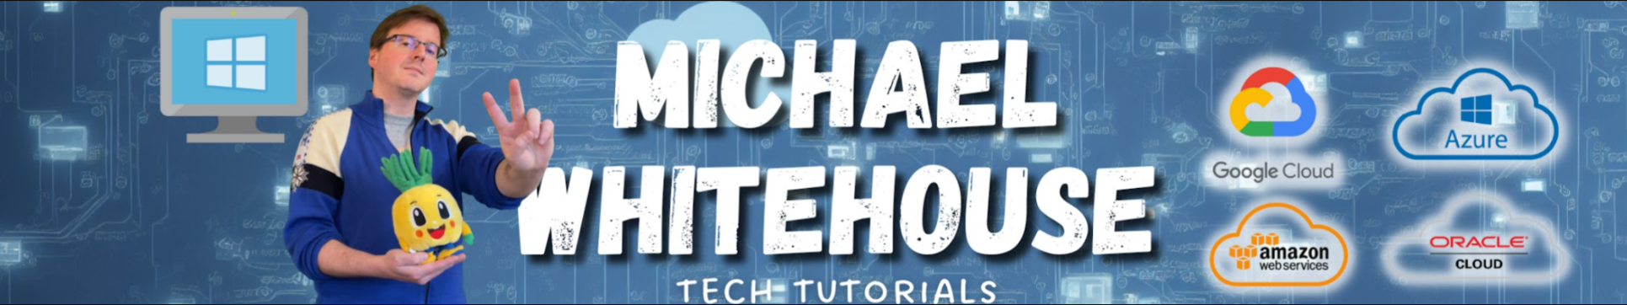
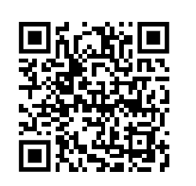
Youtube.com/@mwcloud github.com/kramit mike@michaelwhitehouse.com 9:30am start GMT+1
AZ-305T00A Designing Microsoft Azure Infrastructure Solutions

Slide 3
Let’s get to know each other
Your name
Company affiliation
Title/function
Your experience
Your expectations for the course

Slide 4


Let’s have a great time together
We all contribute to a great class
What you should know about our facilities
Be on time (class hours)
Be present (avoid mail, calls, side meetings)
This placeholder is designed with bulleted text
This section can be removed if the class is online
Accommodations
Internet access
Parking
Restrooms
Emergency
This placeholder is designed with bulleted text
Notes:
In the virtual classroom remove the items that aren’t appropriate. Demo the virtual experience including asking a question, chat, and video. In the physical classroom include things to know about the facilities.

Slide 5
About this course
Purpose – Azure Architects
Subject matter expertise in designing cloud and hybrid solutions
Expertise includes compute, networking, storage, application services, data solutions, monitoring and security.
Prerequisites
Working knowledge of networking technologies including connectivity services, application delivery services, and network architectures.
Working knowledge of storage technologies including relational and non-relational data solutions.
Working knowledge of compute technologies including virtual machines, containers, and PaaS compute solutions. .
Experience architecting solutions including security, migration, and business continuity.
Notes:
Be sure to ask your students about their level of experience. Have they taken AZ-104 (Admin) or another Microsoft course?
Microsoft Learn has a series of Fundamental modules for Azure, networking, and security. More modules are added every day and can help students ramp up on Azure basics. https://docs.microsoft.com/learn/browse/?term=fundamentals&terms=fundamentals&products=azure

Slide 6
Course schedule
Day 1
Day 2
Day 3
Day 4
Introduction
Storage (non-relational)*
App Architecture*
Networks*
Governance*
Storage (relational)*
Authentication and Authorization*
BCDR
Compute*
Data Integration
Monitoring**
Migrations
* Case study
** Fabrikam Residences case study
Notes:
Adjust this slide to your teaching schedule. A more detailed timing table is provided in the Trainer Prep Guide. The table is just a guideline on how you might schedule your class. If you are running behind, consider using the last daily case study as homework. Also, consider using the Module Review questions to recap the day before or after breaks to refocus the class. Some instructors like to complete the case study then use the lecture material for review. Lecture is estimated at 60 – 90 minutes. Case studies are estimated at 60-120 minutes. There is a Fabrikam case study for Day 3 that brings together the previous content. Modules that do not have a formal case study will have a small decision scenario at the end. Be sure to read more about the case studies in the Instructor Solution Guide.

Slide 7

Get ready for your Microsoft Certification exam
Exam AZ-305: Designing Microsoft Azure Infrastructure Solutions
Understand the skills measured by the exam
Build confidence in your skills
Study area | Percentage
Design identity, governance, and monitoring solutions | 25-30%
Design data storage solutions | 20-25%
Design business continuity solutions | 15-20%
Design infrastructure solutions | 30-35%
Find in the exam page resources to help prepare
Watch exam prep videos
Review the exam study guide
Take a practice assessment
Notes:
Percentages indicate the relative weight of each area on the exam. The higher the percentage, the more questions you are likely to see in that area.
Exam AZ-305: Designing Microsoft Azure Infrastructure Solutions - https://docs.microsoft.com/learn/certifications/exams/az-305

Slide 8

Case studies
Tailwind Traders is modernizing its infrastructure and moving to the cloud -
You have been asked to recommend and suggest new cloud architectures - requirements and tasks are provided in case studies
Make sure to actively participate in small groups or individually
Become familiar with the Azure Architecture Center, Azure Charts, and the Azure Documentation.
Consider the Cloud Adoption Framework and Well Architected Framework as you design your case study solutions (next slides)
Optional hands-on sandboxes are provided on Learn
Notes:
AZ-305 Case Study GitHub - https://github.com/MicrosoftLearning/AZ-305-DesigningMicrosoftAzureInfrastructureSolutions
Be prepared to discuss how students should approach the case studies. How will they participate? Will they be expected to present a solution? What tools are available to them to draw architectures or answer questions?
Use this slide and the next two slides to give students areas to explore and use in class.

Slide 9
Microsoft’s Cloud Adoption Framework
Notes:
Consider talking about landing zones specifically. Use this link to review before class https://docs.microsoft.com/azure/cloud-adoption-framework/ready/landing-zone/
The cloud adoption journey - https://azure.microsoft.com/cloud-adoption-framework/#cloud-adoption-journey
Azure migration guide overview - https://docs.microsoft.com/azure/cloud-adoption-framework/migrate/azure-migration-guide
Azure cloud migration best practices checklist - https://docs.microsoft.com/azure/cloud-adoption-framework/migrate/azure-best-practices
Microsoft Cloud Adoption Framework for Azure - https://docs.microsoft.com/learn/modules/microsoft-cloud-adoption-framework-for-azure/
Strategy – Define business justification and expected outcomes of adoption
Plan – Align actionable adoption plans to business outcomes
Ready – Prepare the cloud environment for the planned changes
Adopt (Migrate/Innovate) – Migrate and modernize existing workloads / Develop new cloud-native or hybrid solutions
Govern – Govern the environment and workloads
Manage – Operations management for cloud and hybrid solutions
Organize – Align the teams and roles supporting your organization’s cloud adoption efforts

Slide 10
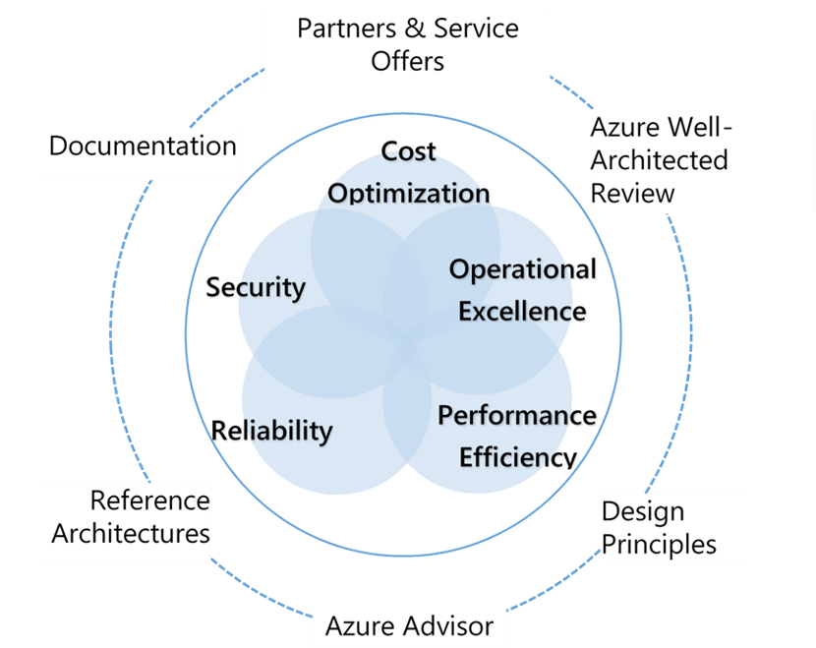
Microsoft Azure Well-Architected Framework
Cost Optimization – Managing costs to maximize the value delivered
Operational Excellence – Operations processes that keep a system running in production
Performance Efficiency – Ability of a system to adapt to changes in load
Reliability – Ability of a system to recover from failures and continue to function
Security – Protecting applications and data from threats
Notes:
Microsoft Azure Well-Architected Framework - https://docs.microsoft.com/azure/cloud-adoption-framework/
Build great solutions with the Microsoft Azure Well-Architected Framework - https://docs.microsoft.com/azure/architecture/framework/
Azure’s Well-Architected Framework targets a specific workload, and the Cloud Adoption Framework picks them up from the point of migration to the cloud.

Slide 11
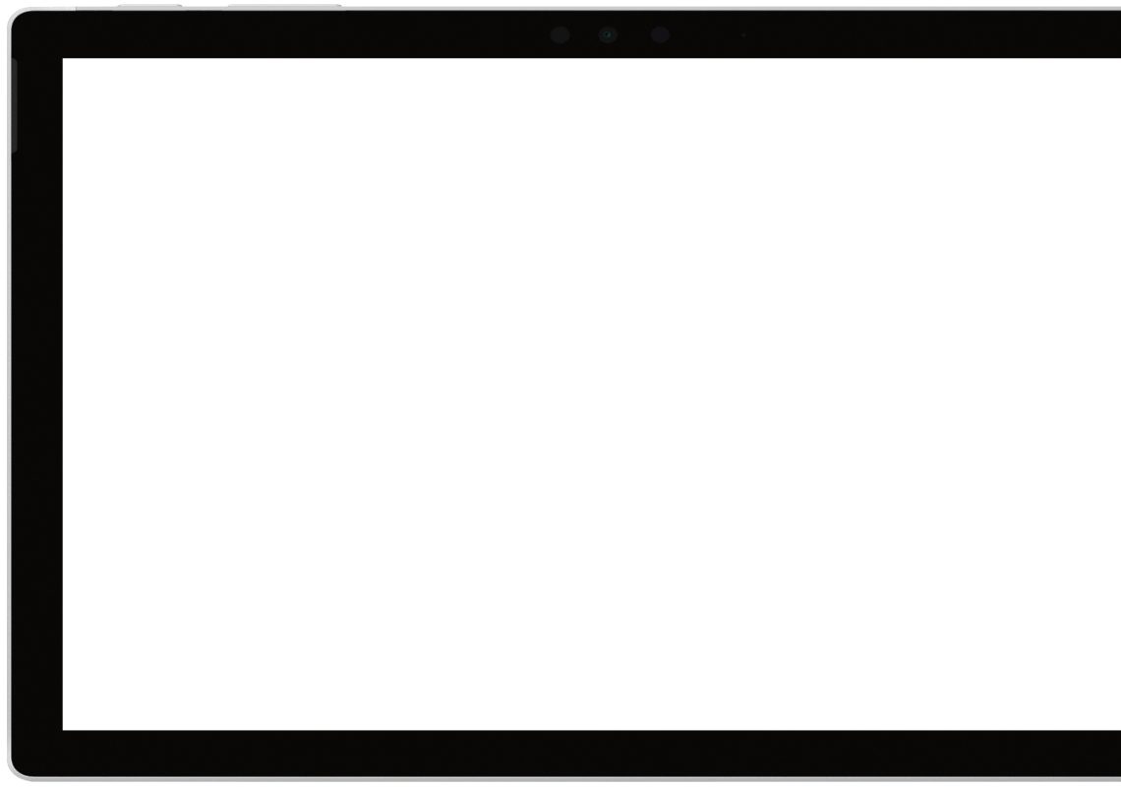

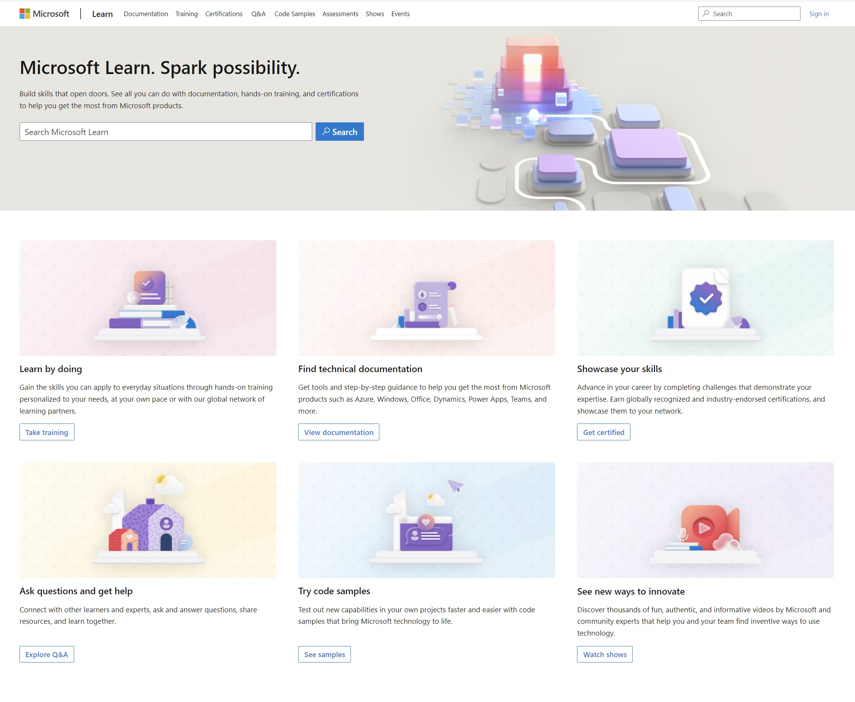
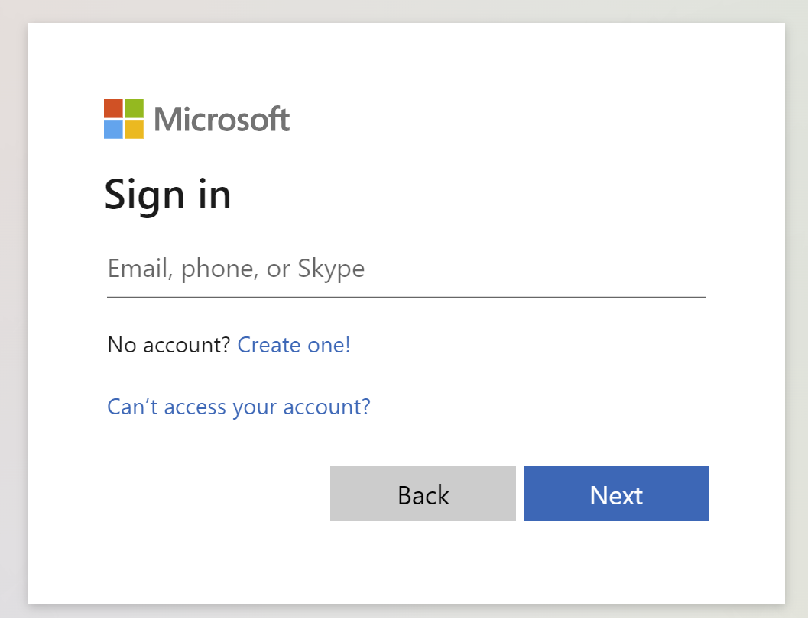
Get the most out of your Microsoft Learn profile
Create your Microsoft Learn profile at learn.microsoft.com
Verify, track, and share your training and certification progress and accomplishments—all on one platform
Select Sign in at the top, right corner of any Microsoft Learn page.
Follow the Microsoft account authentication process.
If the account that you have chosen to sign-in with doesn't already have a Microsoft Learn profile, you’ll be guided to create one.
Claim your achievement code for this course and share you have completed it.
Access your course material and track progress on your learning activities.
Share and verify your Microsoft Certifications via email, on social networking platforms, and on your résumé.
Download and print transcripts and certificates.
Manage your upcoming activities and certification exam appointments.
www.aka.ms/MyMicrosoftLearnProfile

Slide 12
Access your course materials
All course content is available on Microsoft Learn
Learn materials
Hands-on materials
Secure storage for Azure Files and Azure Blob Storage - Training | Microsoft Learn
We’ll go through this content together and as the course progresses, I will advise you on which modules to review.
You can provide feedback for modules on Microsoft Learn. Find how at the bottom of each page.
This course includes case studies
Notes:
There are Learning Paths for this course - https://learn.microsoft.com/certifications/exams/az-305/?tab=tab-learning-paths
Hands-on case studies GitHub - https://github.com/MicrosoftLearning/AZ-305-DesigningMicrosoftAzureInfrastructureSolutions

Slide 13
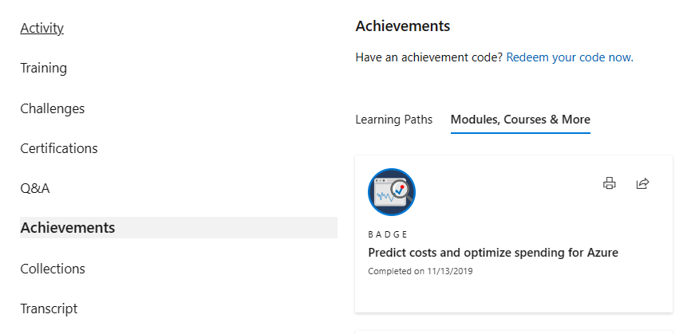
Celebrate your accomplishments and feel empowered
Get your achievement recognized and earn your badge for completing this course
aka.ms/MyMicrosoftLearnProfile
2
Go to Achievements on your Microsoft Learn profile
Redeem the code provided by your trainer
Find your new badge on Modules, Courses & More
Share your new achievement with your professional network. You can also download and print your certificate.
3
4
1

Slide 14

Become Microsoft Certified
92%
of certified IT professionals feel more confident in their abilities after earning certifications¹
Get recognized by earning industry validation for technical knowledge. Ensure you stay current with the necessary skills and expertise for continued success​.
Start at learn.microsoft.com/certifications
Microsoft role-based and specialty certifications require annual renewal.²
Learn about certification renewal at aka.ms/RenewYourCert
¹ “2023 Value of IT Certification | Candidate Report,” Pearson VUE, 2023 ² Microsoft fundamentals certifications don’t expire

